Slide 1
OSCE-III
Respiratory

Slide 2
Asthma
Asthma predictive index
major
  Parental asthma
  Atopic dermatitis/ eczema
  Inhalational senistization
Minor
  Allrgic rhinitis
  Wheeze apart from cold
  >4% periphral blood eosinophilia
  Food allrgies
Notes:
For preschool children with frequent wheezing in the past one year; 1 major and 2 minor criteria has a specificitiy of 97%
+ve predictive value of 77%

Slide 3
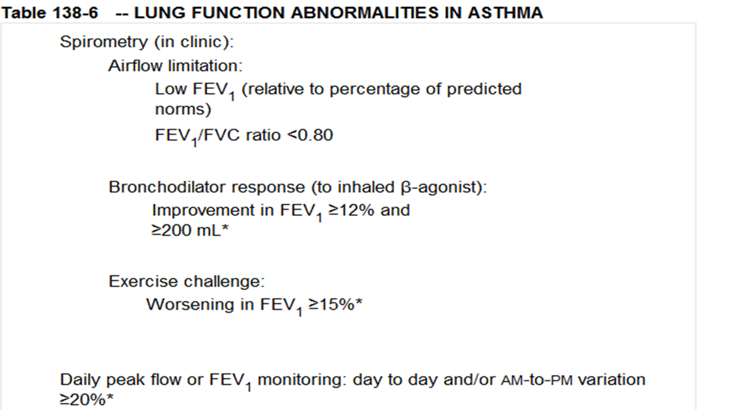
DX
Notes:
Spirometry :feasible in children > 6 yr of age.

Slide 4
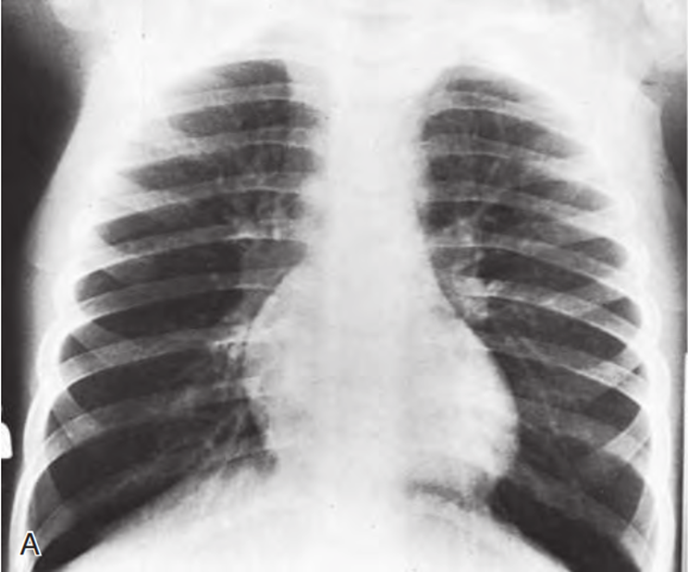
Cont’d
CXR
  Hyperinflation
  Atelectasis
  Pneumo mediastinum
  Pneumo thorax

Slide 5
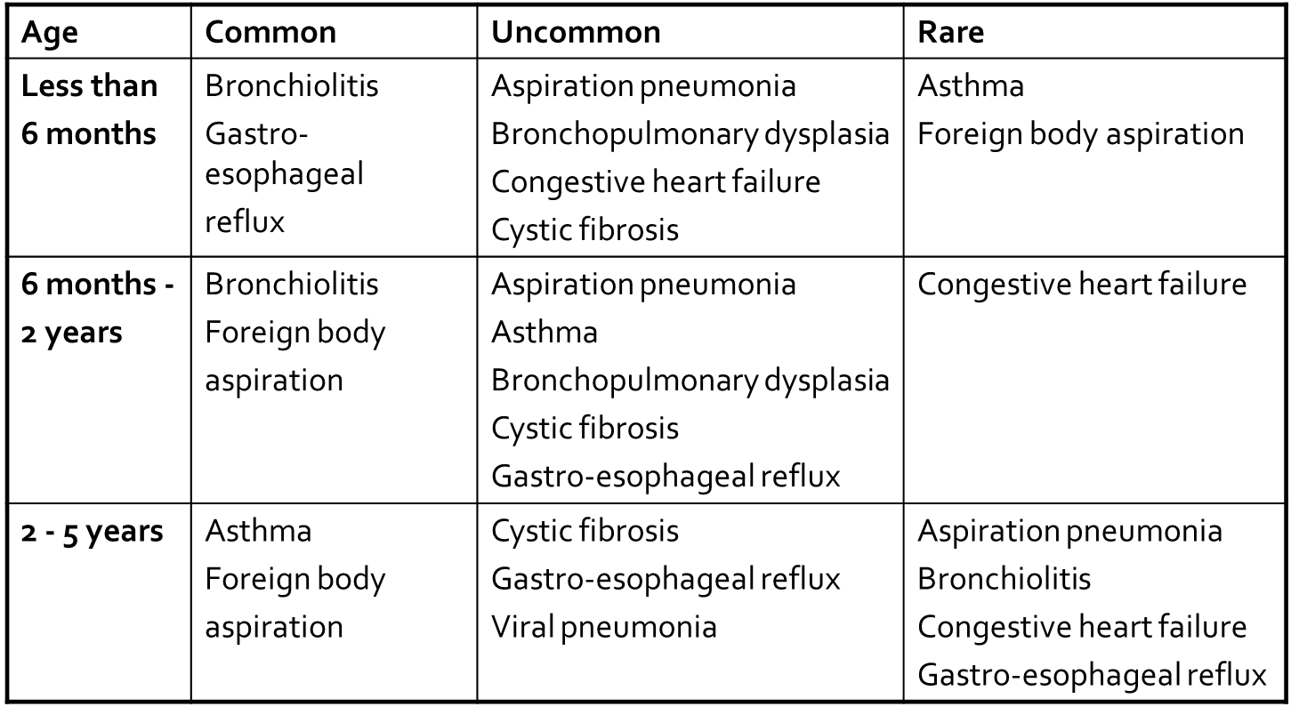
Cont’d
DDX

Slide 6
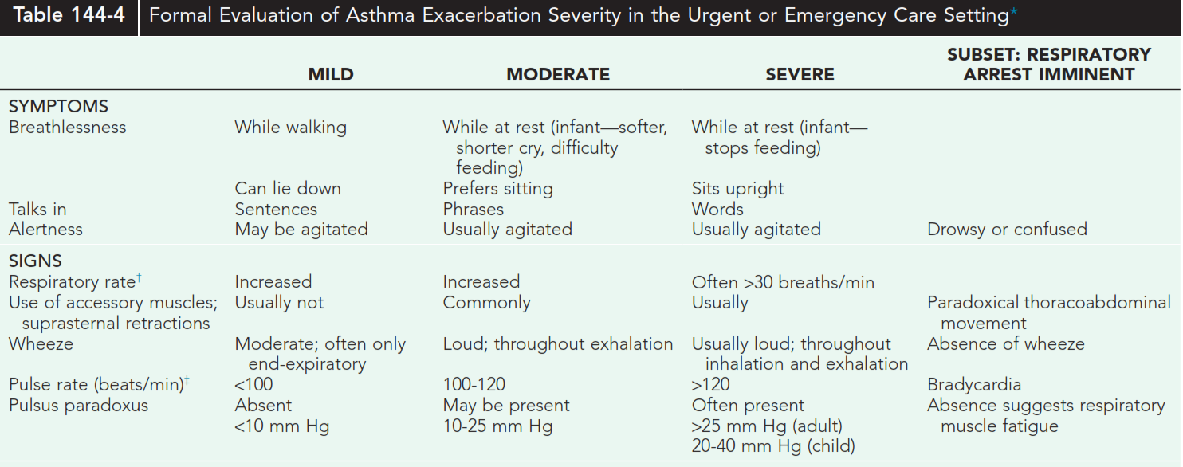
Severity ass’t at emergency

Slide 7
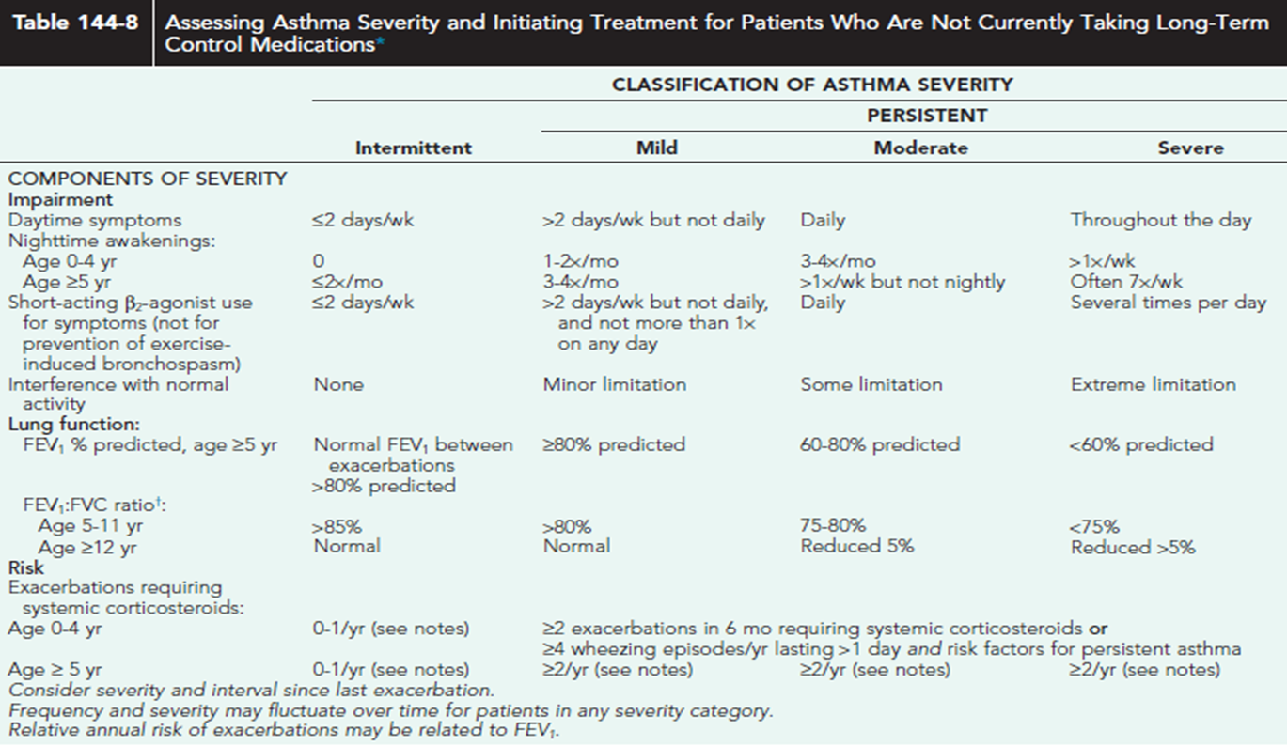
Severity ass’t for pt not on long term medication

Slide 8
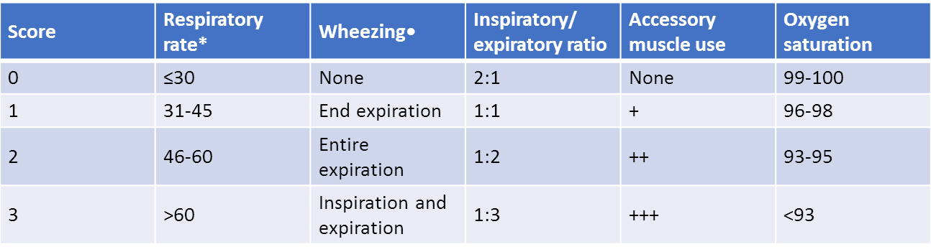
Pulmonary index score (PIS)
score of 7 to 11: moderate severity
≥12 indicates a severe attack

Slide 9
Con’d
Danger Signs
  Silent chest on auscultation
  Cyanosis
  Bradicardia,
  Profound diaphoresis
  Paradoxical breathing
  Drowsiness or confusion
  Agitation
  Exhausion

Slide 10
Asthma- MX
Quick-Reliever Medications
  Short-Acting Inhaled β-Agonists
  Anticholinergic Agents
  Systemic Corticosteroids
Long-Term Controller Medications
  Inhaled Corticosteroids
  Long-Acting Inhaled β-Agonists
  Leukotriene-Modifying Agents
  Nonsteroidal Antiinflammatory Agents
  Theophylline
  Anti–Immunoglobulin E (Omalizumab)

Slide 11
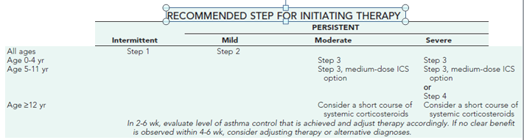
Cont’d

Slide 12
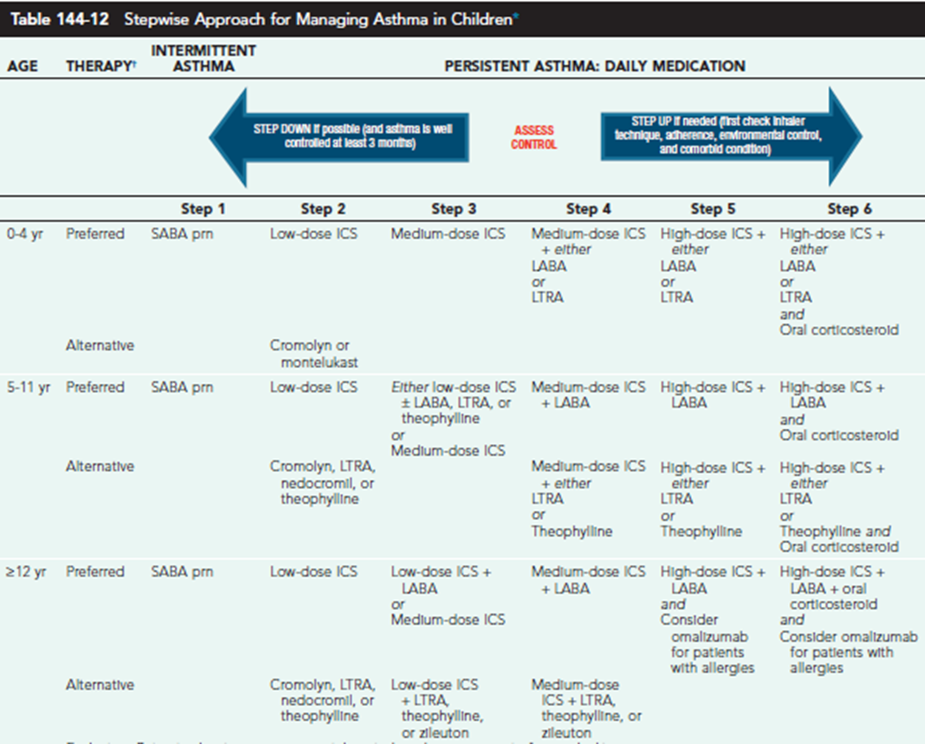

Slide 13
Management of acute exacerbation
1. ABC of life
2. Oxygen: goal > 95% Spo2
3. Give maintenance fluid
4. Rapidly acting brochodiators
Nebulized or metered dose inhalers
5. Steroid ( oral or iv)
Oral- prednisolone
IV- hydrocortisone
If mild to moderate: give steroid when there is no improvement with SABA in 1 hr
If moderate to sever: give SABA & steroid immediately
6. Magnesium sulphate
For sever asthma being treated with SABA & steroid
Safer than Aminophylline
7. Aminophylline
Reserved for those who don’t respond to treatment
Admit to ICU if available

Slide 14
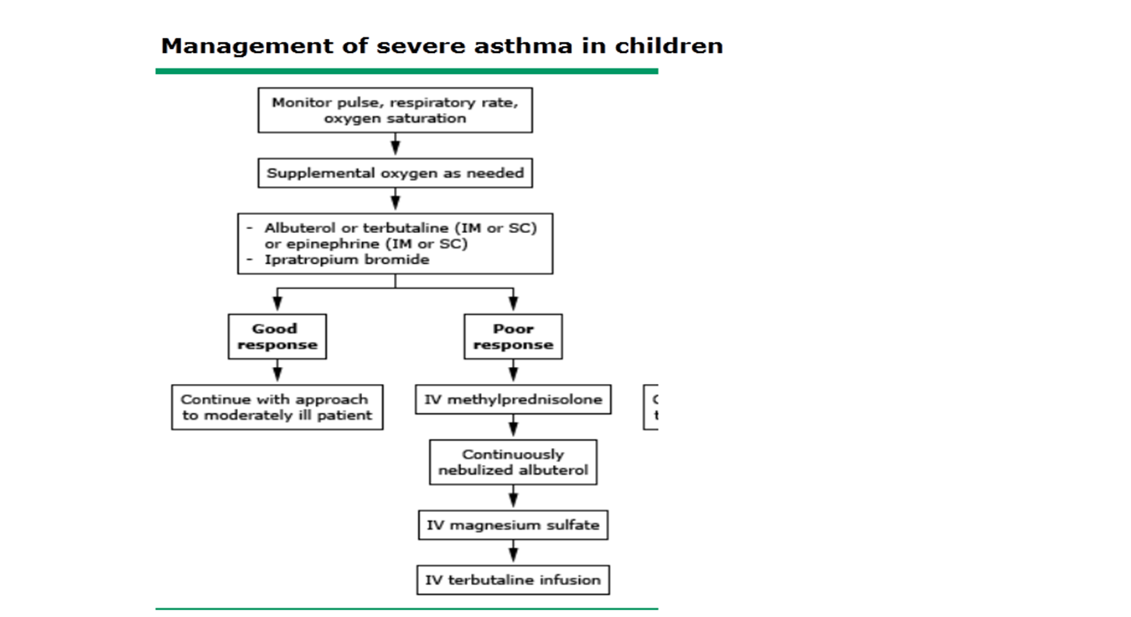

Slide 15
Cont’d
Monitor
  Vital Q3 hr
  If still deteriorating, get CXR
Follow up
  Check for improv’t & reclassify
  Asses medication technique, adherance
  Achieve env’tal control
Discharge
  Sustained improv’t in sx
  PEF> 70% of predicted
  Spo2> 92% at room air for 4 hr

Slide 16
Pertussis
Clinical case definition
cough lasting at least two weeks with at least one of the following symptoms:
  Paroxysms (i.e. fits) of coughing
  Inspiratory whooping
  Post-tussive vomiting without other apparent cause
Criteria for laboratory confirmation
  Isolation of Bordetella pertussis or
  Detection of genomic sequences by means of the PCR or
  Positive paired serology

Slide 17
Cont’d
A child with broken blood vessels in eyes and bruising on the face due to pertussis coughing

Slide 18
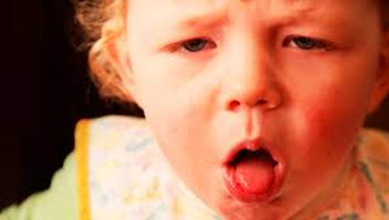
c/f
1.Catarrhal stage (1-2 wk) congestion and rhinorrhea, low-grade fever, sneezing, lacrimation, and conjunctival suffusion.
3. Convalescent stage (≥2 wk), the number, severity, and duration of episodes of cough diminish.
2. Paroxysmal stage (2-6 wk) :
Dry, intermittent, irritative hack and evolves into the inexorable paroxysms that are the hallmark of pertussis.
A well-appearing toddler begin a machine-gun burst of uninterrupted cough on a single exhalation, chin and chest held forward, tongue protruding maximally, eyes bulging and watering, face purple, until coughing ceases and a loud whoop follows as inspired air traverses the still partially closed airway.
Post-tussive emesis followed by exhaustion
more than 1 episode/hr at the peak of the paroxysmal stage

Slide 19
Dx
DDx
Protracted/paroxysmal coughing caused by
  Mycoplasma,
  Parainfluenza viruses,
  Influenza viruses,
  Enteroviruses,
  Respiratory syncytial viruses (RSV), or adenoviruses.
Investigation
WBC: 15-100,000 cells/μl, with predominant lymphocytosis in catarrhal stage, Normal sized lymphocytes (large size in viral infections
Thrombocytosis :556-782,000/μl
CXR : most of the time normal , but may show perihilar infiltrates with butterfly appearance, atelectasis & consolidation if there is secondary bacterial infection
  Occasionally : pneumothorax/mediastinum, SC emphysema
Culture , PCR and serology have limited sensitivity & specificity
Echo: PHtn in severly ill patients

Slide 20
Comp.
Complications
  Pneumonia
    the commnest
    common Mo.: s.aureus, strep. pneum,
Otitis media
Puim. HTn
Convulsion
Malnutrition
Apnea and bradycardia
CNS abnormalities
Bronchiectasis
Forceful cough
  i. hernia
  Petechie
  Cns hemorrhage

Slide 21
Admission criteria:
  Infants < 3mo
  Infants 3-6mo with sever paroxysms
  Premature babies
  Children with underlining cardiac , pulmonic, neurologic or muscular disorders
Non–life threatening paroxysm
  <45 seconds
  Red but not blue
  Tachycardia ,
  bradycardia if not <60/min
  Oxygen desaturation resolving spontaneously
  Whooping or brisk self rescue at the end of paroxysm
  Self expectorated mucus plug
  Post tussive exhaustion bout not unresponsiveness

Slide 22
Mx
ABC of life
Decide on admission
Supportive care
  Airway MX
  oxygen
  Avoid procedures that trigger cough (NGT)
  Antipyretics
  Encourage BF
  fluid
4. Antibiotic
Azithromycin 10 mg/kg safe for 5 days for all age groups
Erythromycin 40-50mg/kg divided in to 4 doses for 14 days for age group above 1 mo
Clarithromycin 15 mg /ke/day devided in 2 doses for 7 days for > 1mo of age
Cotrimoxazole ( TMP8mg/kg/day_ SMZ 40mg/kg/day devided in 2 doses for 14 days for those above 2 mo of age

Slide 23
Discharge
  Infant tolerating cough
  Can feed enough to gain weight
  Caretakers are reliable
  Follow up is assured
Isolation
  Until 5 days of macrolid therapy

Slide 24
Pneumonia
Age and Bacterial Pathogens
Newborns ;
  Group B streptococcus, Escherichia coli, Klebsiella species, Enterobacteriaceae
1- 3 months
  Chlamydia trachomatis
Preschool
  Streptococcus pneumoniae, Haemophilus influenzae type b, Staphylococcal aureus,
  Less common: group A streptococcus, Moraxella catarrhalis, Pseudomonas aeruginosa
School
  Mycoplasma pneumoniae, Chlamydia pneumoniae

Slide 25
Dx
DX
  Mainly clinical
  CRP/ ESR
  PICT
  CXR
  Pleural fluid analysis
  Blood culture
  Sr electrolyte
  Sputum analysis
Indication for cxr
  Recurrent pneumonia
  Complicated
  No response to mx
  Other DX likely
  HIV +ve, sever disease

Slide 26
CXR
  h. pneumonia.. tracheo bronchial
  s. pneum.... lobar consolidation
  GAS.... interstitial
  s.aureus …pneumatocle
  Atpicals also pcp... intertitaial infilterrate

Slide 27
Comp
Local
  Pleural effusion
  Empyema
  Pneumothnorax
  Bronchopulm. Fistula
  Lung abcess
Systemic
  Meningitis
  Pericardits
  Endocarditis
  Osteomylitis
  Septic arthritis
  sepsis

Slide 28
Mx
Admission criteria
Age <3mo
Multiple lobe involv’t
Immunocompromised
Toxic appearance
Moderate- sever resp. distress
O2 need
Complicated pneumonia
DHN
Inability to tolerate PO
NO response to PO med
Social factor

Slide 29
Cont’d
Out pt
  Amox. 40-50 mg/kg/ day TID for 7-10 days or
  Cotrimoxazole 48mg/kg/day
  Antipyretics
  Azitromycin 10mg/ kg/ day for school age
In pt
  ABC of life
  Oxygen
  Antibiotic therapy
  Fluid
  Nutritional
  Antipyretics
  Anti pain

Slide 30
Cont’d
Inpt (antibiotic therapy)
  Crystalline penicilline or
  Ampicillin + gentamycin in immunocompromised sever malnutriton
second line
  Ceftriaxone
Discharge
  Resp distress resolve
  No hypoxemia
  feeding well
  Completed parentral AB

Slide 31
Bronchiolitis
DX
  Clinical
  a previously healthy infant presenting with a first time wheeze
  CBC- usually normal
  CXR
Admission criteria
  Apnea
  SaO2 < 90%
  Inability to feed or drink
  Convulsion
  Moderate to sever resp . distress

Slide 32
Cont’d
Mx
  Oxygen
  Fluid
  Antipyrtics
  Nutrition
  Ab is not needed unless pneumonia
Compilation
  DHN* commonest cause of death
  atelectasis
  Tension pneumothorax

Slide 33
Foreign body
Larynx – 3 %
Trachea/carina – 13 %
Right lung – 60 %
Left lung – 23 %
Bilateral – 2 %
DX
CXR
  Localized wheeze: hyper inflation best seen on Exp view
  Absent air entry: atelectasis, mediastinal shift, compensatory hyperinflation of the other lung; best seen with insp view

Slide 34
Mx
<1 year: 5 Back slaps and 5 chest thrusts
Heimlich Maneuver
If rigid bronchoscopy is unsuccessful, surgical bronchotomy or segmental resection may be necessary
Chronic bronchial obstruction with bronchiectasis and destruction of lung parenchyma may require segmental or lobar resection
Antibiotics for secondary infections
Steroids for inflammation
Treat complications

Slide 35
Croup (laryngotracheobronchitis)
Cause
  Rhinovirus
  RSV
  Para influenza
CF
  Illness often begins with rhinitis
  Cough - harsh or ‘‘barking’’ and inspiratory stridor
  Airway obstruction
  Onset of stridor usually occurs over 6–12 hours

Slide 36
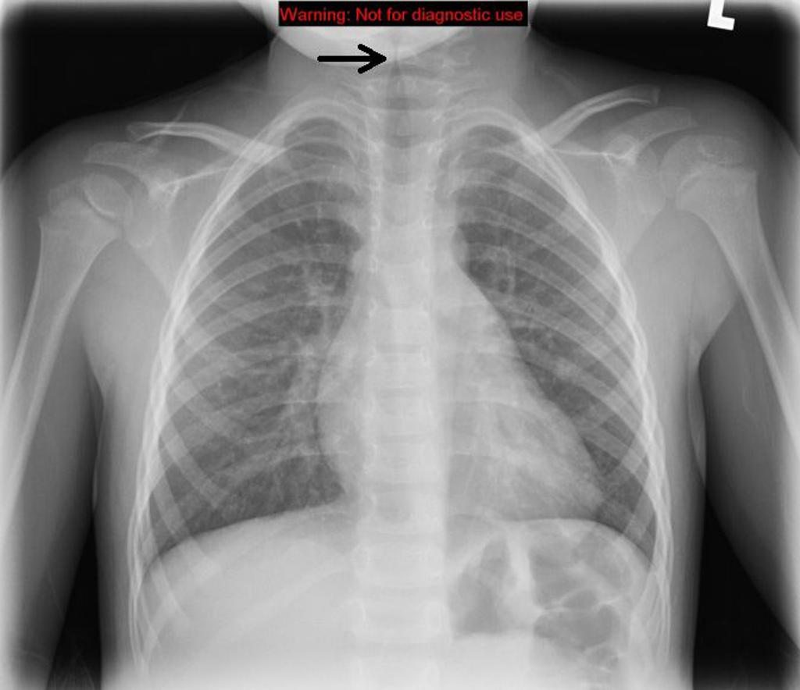
DX
CXR
  Steeple sign or inverted pencil sign
Laryngoscope
  Erythematous edema with destruction of the epithelium

Slide 37
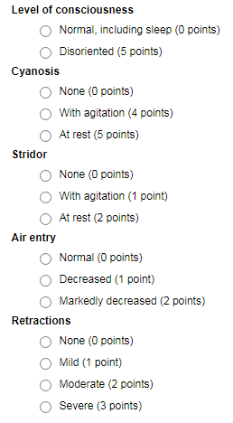
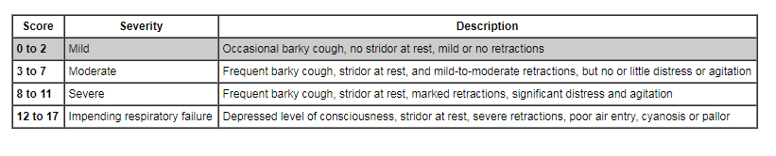
Westley croup severity score (appropriate for use in children ≤6 years of age)

Slide 38
mx
ABC of life
Supportive care
Steroid
Nebulised epinephrine
No need of Ab

Slide 39
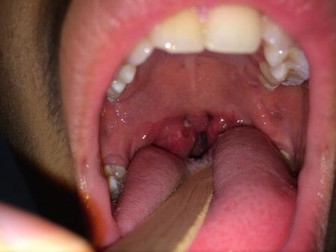
Peritonsillar abscess
GAS and mixed anaerobs are the most common pathogens
Mx
  Cephalexin+/- metronidazole or
  Clindamycin
  Or
  amoxclavulunate

Slide 40
Epiglottitis
Cause
  Hib
  S. pyogens
  Pneumococcus
  S.aureus
CF
  High fever, soar throat, dyspnea
  Swallowing and breathing difficulty
  Tripoid positioning
  Drooling of saliva and hyper extended neck
  Stridor is a late finding

Slide 41
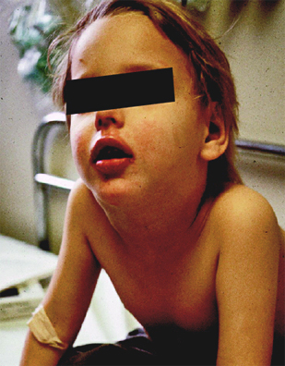
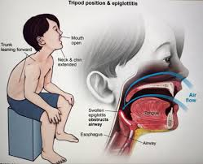
Tripoid positioning

Slide 42
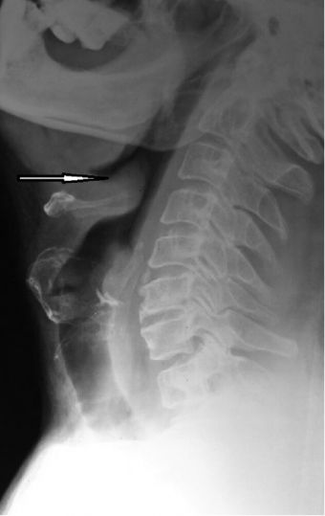
DX
CXR
  Thumb sign o n lateral neck xray
Laryngoscope
  Large cherry red epiglotitis
Blood culture

Slide 43
Mx
ETT or tracheostomy
  oxygen
IV Ab
  Ceftriaxone once daily for 5 days

Slide 44
Stridor DDX
Cruop
Epiglotitis
Laryngeal polyp
laryngeomalasia
tracheomalsia

Slide 45
Tuberculosis

Slide 46
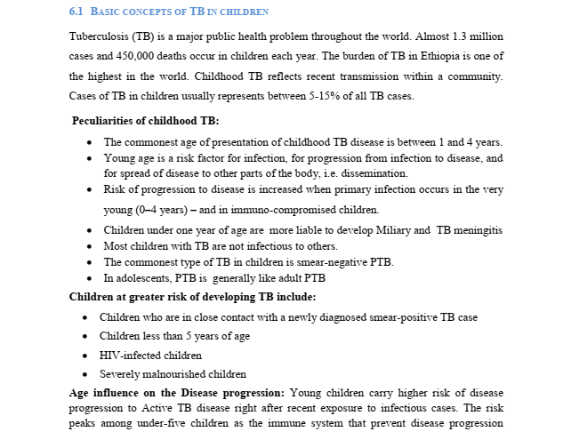

Slide 47
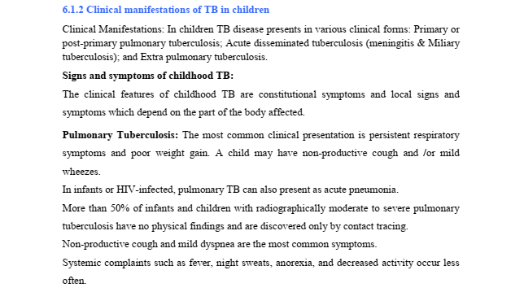
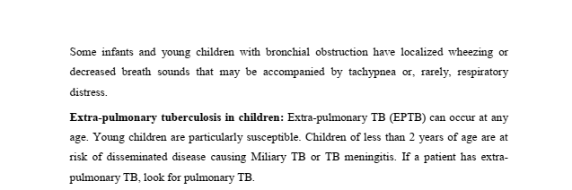

Slide 48
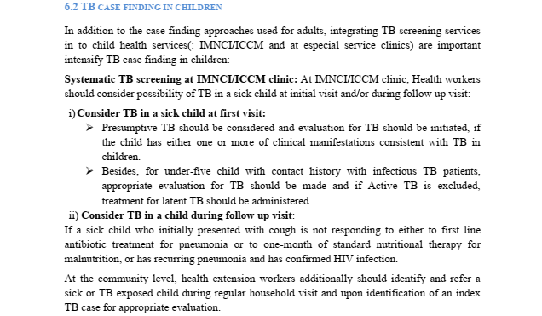

Slide 49
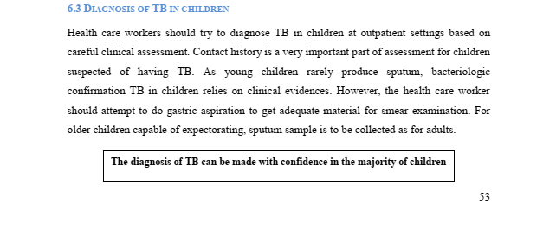
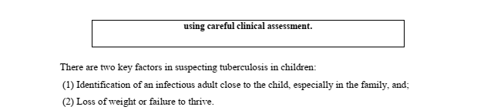

Slide 50
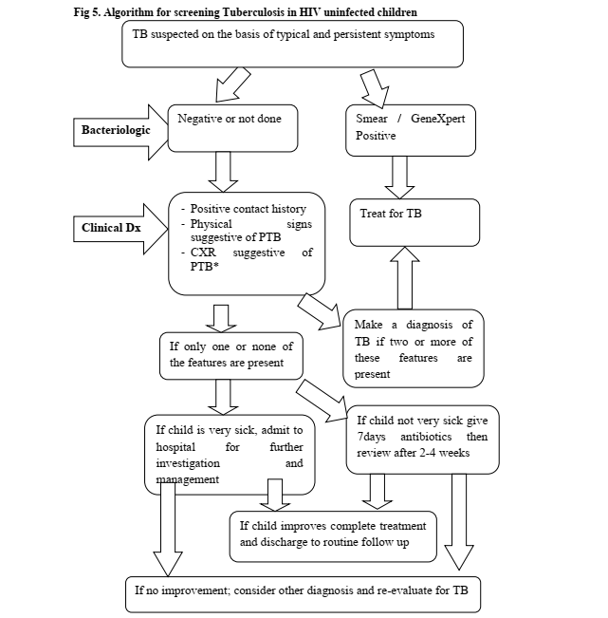

Slide 51
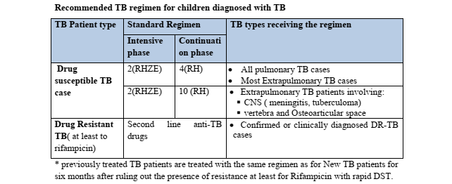

Slide 52
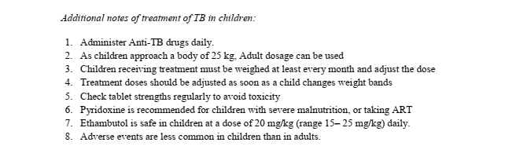


Slide 53
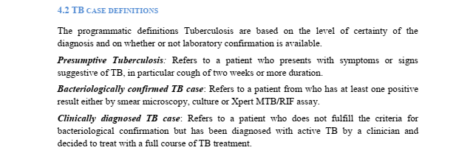

Slide 54
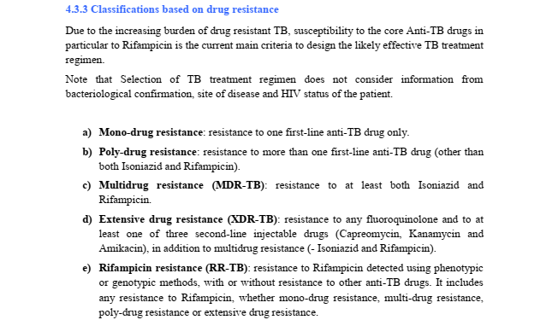

Slide 55

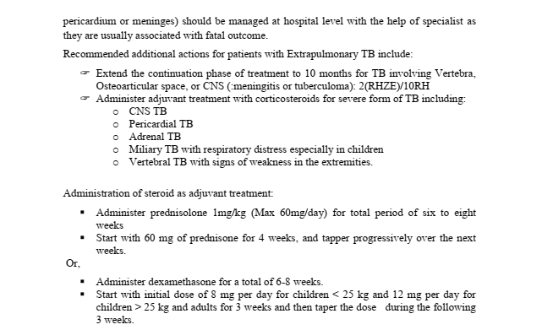

Slide 56
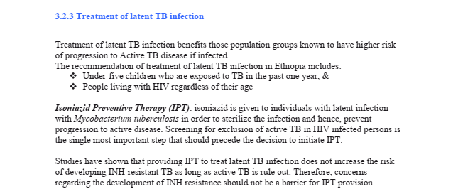

Slide 57
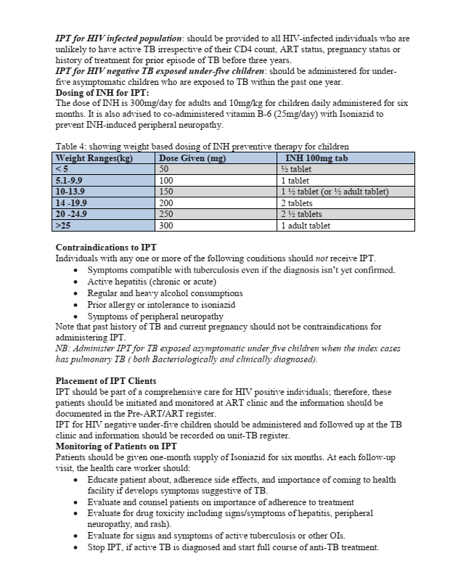

Slide 58
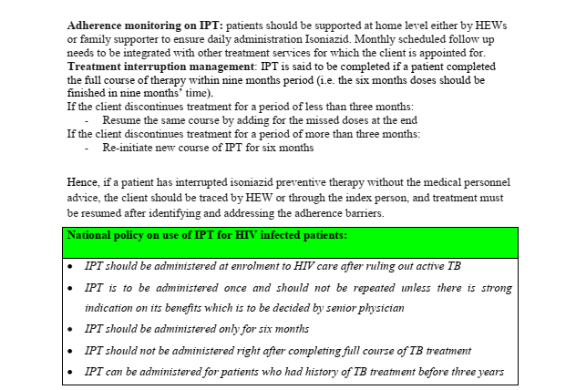

Slide 59
Differential diagnosis of chronic cough
TB
Hyperactive airway disease
Lung abscess
CHF
Pertusis
Chronic bronchitis..rare
Contact hx,around 95% will develop disease within 2 years of contact
Gastric aspirate
  NPO FOR 4-6 HRS
  30ML NS vis NG tube
  Aspirate after 10-15 minutes

Slide 60
Primary TB is common in pediatric age group
Know when to give steroid
IPT
Scrofula or TB lymphadenitis is the most common form of extrapulmonary TB

Slide 61
TB meningitis
1st stage
Non specific symptoms
  Fever,headache,irritability,drowsiness,malaise
Focal neurological signs absent
Stagnation or loss of developmental milestone
2nd stage
More abrupt
Most common features
Lethargy,nuchal rigidity,seizures,positive PE,vomiting,hypertonia,CN palsy,Focal neurologic signs
Hydrocephalus
Raised ICP
Vasculitis

Slide 62
3rd stage
Coma
Hemi or para plegia
Hypertension
Decerebrate posturing
Deterioration of vital signs
Death
Prognosis
1st excellent
3rd Permanent disability

Slide 63
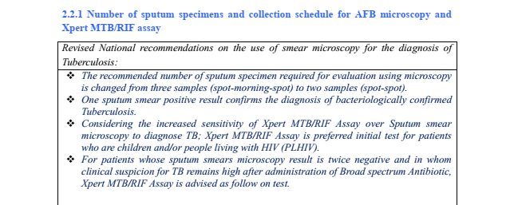
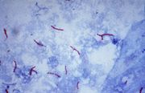
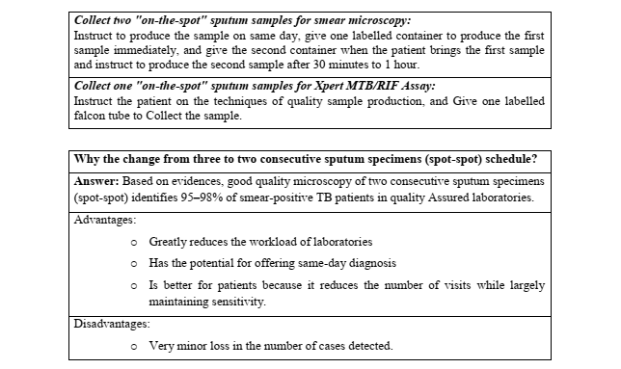
Diagnosis of TB(pul+others)
Key-high index of suspicion
AFB microscopy
  Zeil-nelson’s stain

Slide 64
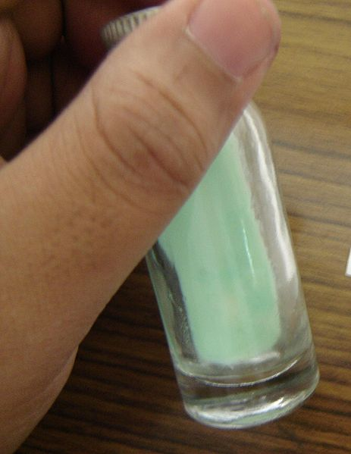
Culture
Culture-sputum/other specimen
  Lowenstein-Jensen or Middle brookmedia(takes 4-8 wek for growth)-popular
  Liquid media-2-3 wk for growth-by PCR or paper chromatography
Solid media/ Liquid media

Slide 65
Diagnosis of TB(pul+others)
Neuclic acid amplification
    Within hours-lower sensitivity/high cost
    To confirm-smear +ve or for smear _ve or EPTB
    LPA
    Gene Xpert
Drug susceptibility test
    Relapse,failure cases
    Media (solid-slow,fluid-fast)
    PCR-mutation-markers
Radiography
    “Classic”-upper lobe inflitrate/cavity,post primary,lower lobe/hilar Lap-primary/atypical

Slide 66
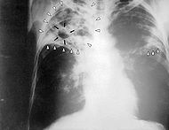
Fibrotic- cavity

Slide 67
Primary tuberculosis: A 31-year-old woman from
Taiwan with mild cough and fever. There is an infiltrate in the right lower lobe. PPD was positive. Primary TB must be considered in the differential of this radiograph. (Courtesy of Wallace Miller, Jr.,

Slide 68
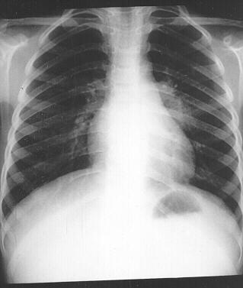
Primary tb

Slide 69
Reactivation tuberculosis: A 31-year-old man with persistent right chest pain. A. View of the lung apices demonstrates an indistinct pulmonary opacity in the left apex.Sputum cultures were positive for M. tbc

Slide 70
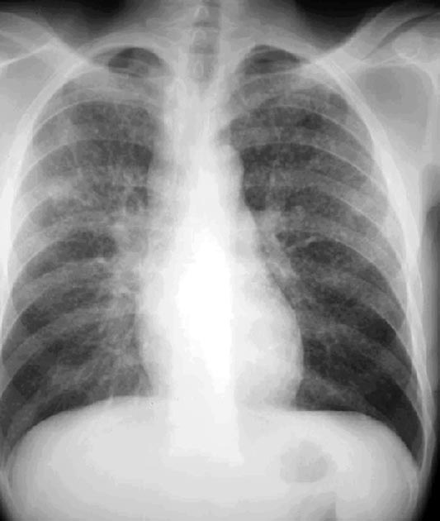
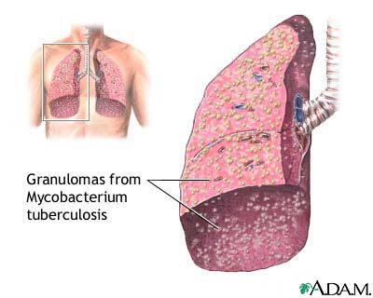
Milliary tb

Slide 71
Diagnosis of TB(pul+others
PPD skin test
    For screening test for M.tbc infection
    Limited value for diagnosis b/c low sensitivity/specificity
Additional diagnostic procedures
  Smear/ culture on
    Sputum induction-dry cough
    Bronchoscopic BAL/transbronchial biopsy
    Gastric lavage-children(early morning)
EPTB
  CSF analysis, culture
  Body fluids: analysis/smear/culture/ADA
  Tissues: Pleural tissue/LN
  Bone marrow-milliary
  Liver biopsy/culture-high in HIV
  Urine-AFB on culture _ve pyuria ,IVP
  U/S,C/T/MRI
Notes:
False Negative:
Immunocompromised patient
Overwhelming tb-milliary
Malnutrition
Malignancy
False positive
Previos BCG vaccination
Nontuberculous mycobacterial infection

Slide 72
Principles of management
1.Chemotherapy
Act on different population of the bacteria
2.Response
Side effect
Appetite
Weight gain
3.Rehabilitation
Malnutrition
4.Screening
Children<5
Immunosuppression
>5years symptomatic
Do investigation…if positive treat for TB if not INH prophylaxis for 6 months

Slide 73
TREATMENT OF TB
Chemotherapy
    1.cure of the patients
    2.prevention of death from active TB and late effect
    3.avoid relapse or recurrence
    4.prevention of spread of drug resistance organism
    5.protection of the community
First line essential drugs
  bactericidal-R,H,Z,S
  bacteriostatic-E,T
Second line drugs
The bacteria population consists of
    1.metabolically active,continuosly growing bacteria which are in walls of tuberculous cavity
    2.intracellular bacilli
    3.semidormant bacteria which undergo spurts of metabolism and
    4.dormant bacilli which die off gradually on their own
Mechanism of action
  INH-most potent bactercidal
    Kills 90% bacilli in few days
    Most active againist metabolical active/growing m.o
  Rifa
    Good bactericidal(for semidormant)good sterilizing agent-prevent relapse
  PZA
    Kills intracellular mo
    Sterlizing agent
    For initial phase-no importance beyond 2 months

Slide 74
Principles of antiTB chemotherapy
Combination-
  ↓resistance(mutants will be killed by one of the drugs)
  Bacteria of different population
Given for several months(>6 months)
  To kill slow growing organisms/semi dormant bacilli
  To prevent relapse
Resistance low probability-even lower when drugs combined
  MDR
  XDR
Categorization of TB patients by outcome of recent treatment
  New: never treated with anti TB or <1 month treatment
  Relapse: previously treated /completed treatment/smear /culture +ve TB
  Failure: newly diagnosed TB smear +ve at 5th month of treatment
  Return after default: patient come after discontinuation of drugs for 2 month smear +ve

Slide 75
Otitis media

Slide 76
Otitis media
age (peak 6 -15 months)
Gender (m>f)
race
genetic background and socioeconomic status
breast milk feeding
degree of exposure to tobacco smoke
degree of exposure to other children
presence or absence of respiratory allergy
season of the yr
vaccination status
Certain types of congenital craniofacial anomalies are particularly prone to OM
2 main categories:
acute otitis media (AOM)
otitis media with effusion (OME)
Peak during the 1st 2 yrs of life.
Leading reason for physician visits and for use of antibiotics
Figures importantly in the differential diagnosis of fever
Accurate diagnosis of AOM in infants and young children may be difficult
Notes:
More than 80% of children will have experienced at least 1 episode of OM by 3 yr.

Slide 77
Etiologies
Clinical manifestation
variable, especially in infants and young children.
Irritability or a change in sleeping or eating habits and occasionally, holding or tugging at the ear.
Vomiting
Fever
Rupture of the tympanic membrane with purulent otorrhea (uncommon)
Systemic symptoms and symptoms of URTI
Asymptomatic disease discovered at a routine health examination.
OME often is not accompanied by overt complaints but can be accompanied by hearing loss.
Usually complicate URTI (Viral/bacterial)
Acute otitis media
Streptococcus pneumoniae
Nontypeable Haemophilus influenzae (conjunctivitis + OM)
Moraxella catarrhalis
Otitis Media with Effusion
Only 30 % culture positive
bacterial DNA and viral RNA in much larger proportions

Slide 78
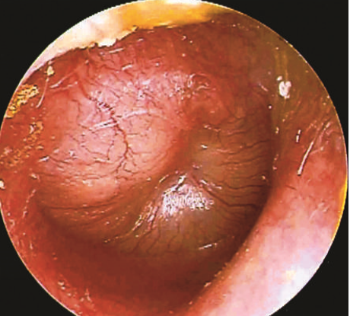
Dx
Otoscopy
Moderate to severe bulging of the TM or
new-onset otorrhea not caused by
otitis externa
Mild bulging of the TM and recent (<48 hr)
onset of ear pain or intense TM erythema
A diagnosis of AOM should not be made in
children without MEE
Tympanometry : dx MEE
Of all the visible characteristics of the TM, mobility is the most sensitive and specific in determining the presence or absence of MEE
Bulging of the TM is the most specific finding of AOM (97%) but has lower specificity (51%)
Otitis media with effusion (OME) is defined as the presence of middle-ear effusion (MEE) in the absence of acute signs of infection.
In OME, bulging of the TM is absent or slight or the membrane may be retracted (Fig. 640-4); erythema also is absent or slight, but may increase with crying or with superficial trauma to the external auditory canal incurred in clearing the canal of cerumen.
tympanogram provides information about TM compliance

Slide 79
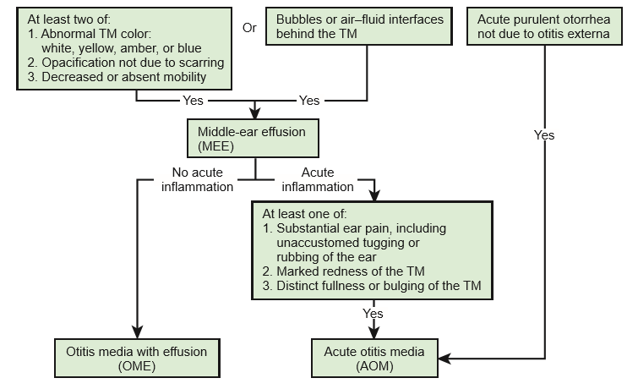
…..
Algorithm for distinguishing between acute otitis media and otitis media with effusion. TM, tympanic membrane

Slide 80
TREATMENT
Supportive care: pain and fever management
Antibiotics ; 10 days course
1st line: Amoxicillin/ amox-clavulunate
2nd line : Cephalosporines
Myringotomy and Tympanocentesis

Slide 81
Complications
Intratemporal : dermatitis, TM perforation, chronic suppurative OM, mastoiditis, hearing loss, facial nerve paralysis, cholesteatoma formation, and labyrinthitis
Intracranial : Meningitis, epidural abscess, subdural abscess, focal encephalitis, brain abscess, sigmoid (lateral ) sinus thrombosis, and otitic hydrocephalus

Slide 82
ACUTE OTITIS MEDIA (OM)
Suppurative infection of the middle ear cavity
The common bacterial pathogens are
S.pneumoniae
Nontypable H.influenzae
M.catarrhalis,
less frequently GAS
Peak incidence of acute otitis media is in the second 6 months of life
The major risk factors for acute OM are
Congenital Anomalies
Young age
No breast feeding
Parental history of ear infection, the presence of a sibling in the home (especially a sibling with a history of ear infection).
Passive exposure to tobacco smoke from parental smoking .

Slide 83
OTITIS MEDIA CONT…
CLINICAL MANIFESTATIONS
In infants the frequent symptoms of acute OM are nonspecific & include fever, irritability, and poor feeding
Older children and adolescents ,acute OM usually in association with fever & otalgia (acute ear pain)
Acute OM also may present with otorrhea, or ear drainage after spontaneous rupture of tympanic membrane
Investigation
Otoscopic examination
Tympanometry

Slide 84
OTITIS MEDIA CONT…
TREATMENT
Amoxacillin 80-90mg/kg po tid for 10 days
Amoxacillin- clavulanate 80-90mg/kg if above treatment fails

Slide 85
COMPLICATION OF AOM CONT…
INTRACRANIAL COMPLICATIONS
Meningitis, epidural abscess, subdural abscess, focal encephalitis, brain abscess
Sigmoid sinus thrombosis (also
called lateral sinus thrombosis), and
Otitic hydrocephalus
Intratemporal Complications
Dermatitis
TM perforation
Chronic suppurative OM (CSOM)
Acute mastoiditis
Hearing loss
Facial nerve paralysis
Cholesteatoma formation- is an abnormal accumulation of squamous epithelium within the middle ear and mastoid.
Labyrinthitis

Slide 86
…..
Algorithm for distinguishing between acute otitis media and otitis media with effusion. TM, tympanic membrane

Slide 87
TREATMENT
Supportive care: pain and fever management
Antibiotics ; 10 days course
1st line: Amoxicillin/ amox-clavulunate
2nd line : Cephalosporines
Myringotomy and Tympanocentesis

